Slide 1


CS-482: Introduction to Blockchain and CryptoCurrency
Lecture # 11: Altcoin and the Cryptocurrency EcoSystem
Prof. Dr. Sufian Hameed
Department of Computer Science
FAST-NUCES
FAST-NUCES
Notes:
1

Slide 2
Short History of Altcoins

Slide 3
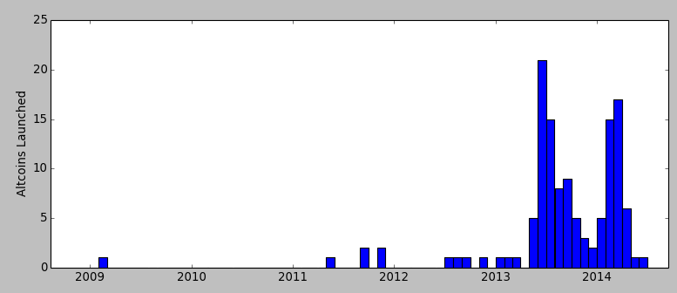
Data from mapofcoins.com
Bitcoin is not alone
Between 500-1000 altcoins launched to date
Dogecoin
Altcoins launched per month
(genesis block)
Litecoin
Namecoin
Peercoin
Bitcoin

Slide 4
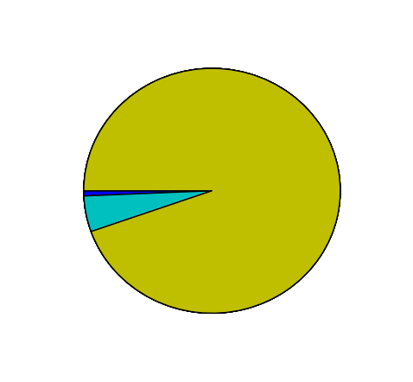
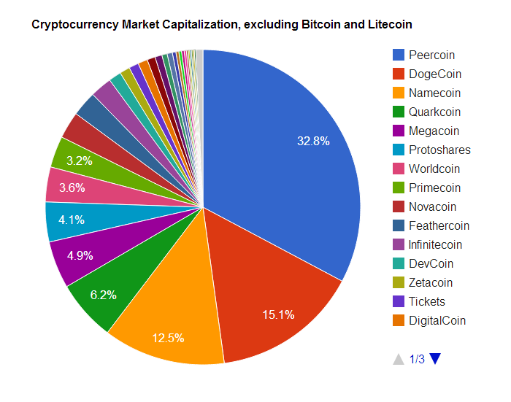
Bitcoin and Litecoin are 99% of total
based on Market Cap (price * total)
Bitcoin (94%)
Others (1%)
Litecoin (5%)
data from Jan 2014
cryptostat.com and bitinfocharts.com

Slide 5
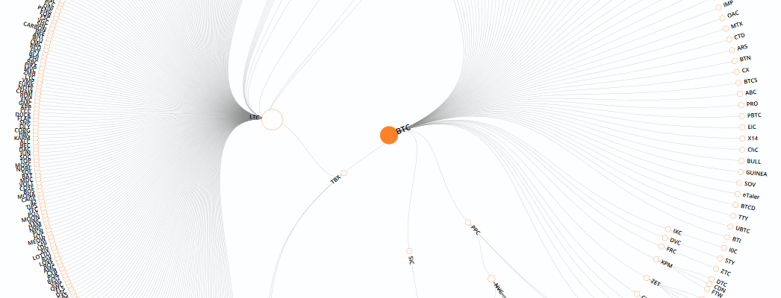
Altcoin genealogy
Litecoin
Bitcoin
Tenebrix
Peercoin
Graphic from mapofcoins.com

Slide 6
Features of altcoins
Better (or different) security
Mining puzzle
Contract/platform features
Different parameters and monetary policy
inflation
inter block time
Community or common interest support

Slide 7

Namecoin
First altcoin (launched in April 2011)
Feature: Domain Name Registration
http://example.bit/
New name costs 0.01 NMC (about 1 cent US)
No renewal fee: must “ping” every 6 months
Names (and subdomains) can be transferred/sold
Can be “merge-mined” with Bitcoin - defined later

Slide 8

Litecoin
Litecoin launched in Sep. 2011
Memory-hard mining puzzle
Intended to be GPU-resistant,
when Bitcoin mining was GPU-based
FPGA, ASICs, arrived but later than BTC
4th most popular, 1st most widely forked
Block rate is 4x faster

Slide 9

Peercoin (aka PPCoin)
Launched August 2012
Hybrid mining:
First Proof-of-Stake algorithm
mine by spending “stake” which accumulates
Proof-of-Work can earn mining rewards
… but aren’t counted for choosing the main chain
Also uses regularly published “checkpoints”
acts as a safeguard, planned to remove in future

Slide 10


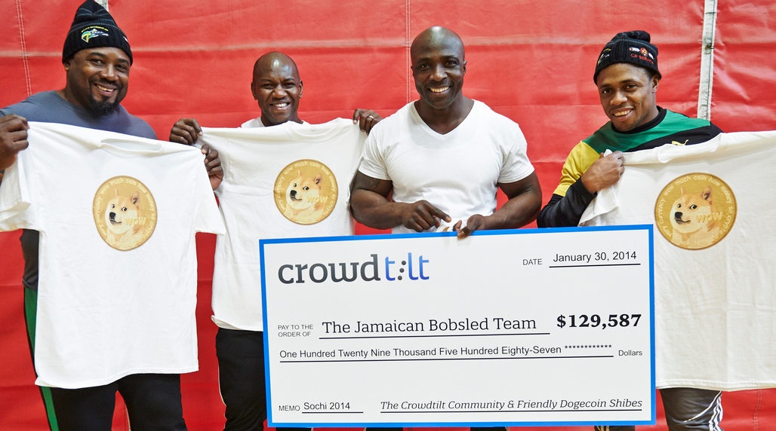
Dogecoin: Culture
Launched in December 2013
Culture - tipping, charity, sponsorship
Notes:
I probably don’t have copyright for any of these two images so I have to delete them. I couldn’t find good alternatives.

Slide 11
Dogecoin: “Random” block rewards
Goal: each block bonus is “random”
Implementation: block bonus is pseudorandom function of previous block hash
Problem: miners know next reward in advance
switch to other altcoin when reward is low
Feature removed in March 2014

Slide 12
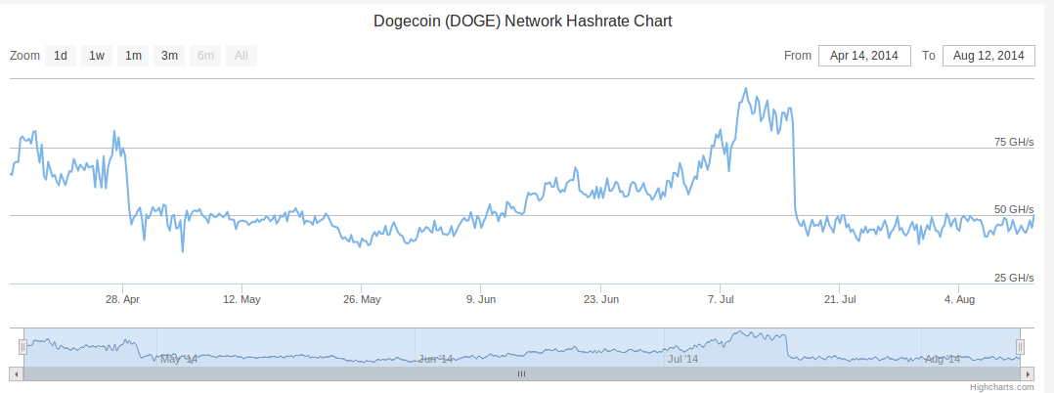
Dogecoin: Mining reward half-life
Mining reward cut in half every two months
Halved
Halved

Slide 13
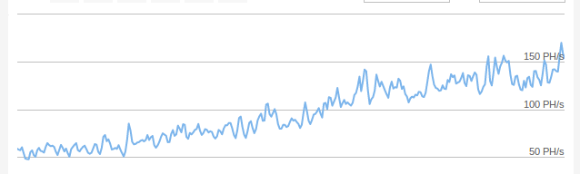
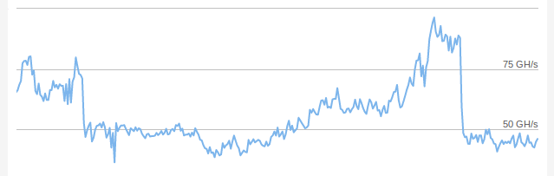
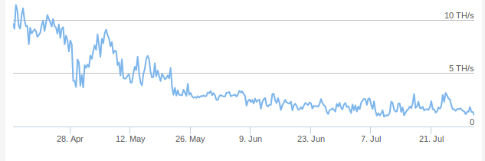
Bitcoin Hashrate
Compare altcoins: Hashrate/time
Dogecoin Hashrate
{Declining Altcoin} Hashrate

Slide 14
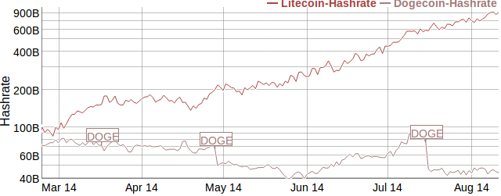
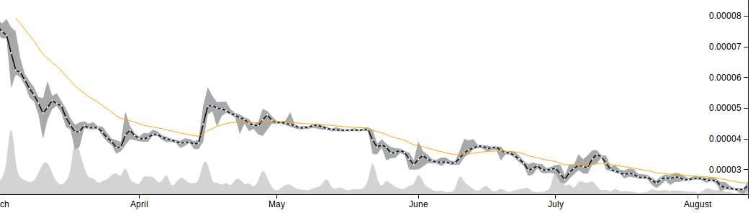
Compare altcoins: Hashrate and price change
Dogecoin vs. Litecoin Price (Cryptsy)

Slide 15
Metrics for comparing altcoins
Market cap (price * total number of coins)
Overestimates value (but by how much?)
Doesn’t account for lost / out-of-circulation coins
Exchange volume
Depends on nature of third party exchanges
Can be moved deliberately
Total hashpower (for similar puzzles)
Merchant support and usage?

Slide 16
Interaction between Bitcoin and altcoins

Slide 17
Mining attacks
Even a small miner (or mining pool) on a large network can demolish a small altcoin
Attacks like this have happened before:
Jan 2012: CoiledCoin - by Eligius pool
Jul 2013: TerraCoin - unknown
Nov 2013: WorldCoin - unknown
Notes:
terracoin: https://bitcointalk.org/index.php?topic=261986.0
world coin: http://worldcoinforum.org/topic/456-confirmed-51-attack-double-spend-attack-on-worldcoin/

Slide 18
Merge mining
Ordinarily, mining is exclusive
Each attempt either has a chance to be a Bitcoin block,
or has a chance to be an Altcoin block
Obstacle to bootstrapping
What if we could mine Altcoin blocks
AND Bitcoin blocks at once?

Slide 19
Merge mining
Ordinarily, mining is exclusive
Each attempt either has a chance to be a Bitcoin block,
or has a chance to be an Altcoin block
Previous Bitcoin block
Bitcoin transactions
H(prev || merkl_root || nonce) < TARGET
Previous Altcoin block
Altcoin transactions
H(alt_prev || alt_merkl_root || nonce) < TARGET

Slide 20
Merge mining: How it works
H(prev || merkl_root || nonce) < TARGET
H(prev || merkl_root || nonce) < TARGET
a valid Altcoin block
tx[0] (coinbase)
scriptSig:
scriptPubKey: …
alt header
alt_prev, alt_merkl_root
alt header
tx[1] …
tx[2] …
Coinbase scriptSig is ignored by Bitcoin
valid Altcoin transactions
...
...

Slide 21
Merge mining
Merge mining is a mixed blessing
Easier to recruit participants
Cheaper for attackers (e.g. CoiledCoin)
Miners might not validate transactions
Many mining pools merge-mine several coins
GHash.IO: Bitcoin, Namecoin, IXCoin, Devcoin

Slide 22




Atomic cross chain swaps
with TierNolan’s protocol
Problem: Alice has 1 BTC, Bob has 1 LTC
They want to swap, but who goes first?
Goal: Either both transactions complete, or neither do
Alice
Bob

Slide 23
Atomic cross chain swaps
Step 1: Alice generates secret x, Alice&Bob sign RefundA
x, h=H(x)
DepositA
Either sigA and sigB
Or sigB and
reveal x where H(x)=h
RefundA
Timelocked to T+2
Signed by Bob
Signed by Alice
Alice
- Alice generates DepositA, but doesn’t publish it yet
- Alice generates RefundA, and gets Bob’s signature on it
- Once RefundA is signed, she publishes DepositA
- If Bob learns x before time T+2 , he can take the 1BTC
- If Alice does not reveal x, she can claim her refund at T+2
Bob

Slide 24
Atomic cross chain swaps
Step 2: Bob deposits 1LTC, Alice&Bob sign RefundB
- Bob generates DepositB, but doesn’t publish it yet
- Bob generates RefundB, and gets Alice’s signature on it
- Once RefundB is signed, he publishes DepositB
- If Alice reveals x before time T+1 , she can take the 1LTC
- If Alice does not reveal x, Bob can claim his refund
x, h=H(x)
Alice
DepositB
Either sigA and sigB
Or sigA and
reveal x where H(x)=h
RefundB
Timelocked to T+1
Signed by Bob
Signed by Alice
Bob

Slide 25
Atomic cross chain swaps
Step 3: Alice reveals x, both players claim their coins
x, h=H(x)
DepositA
Either sigA and sigB
Or sigB and
reveal x where H(x)=h
RefundA
Timelocked to T+2
Signed by Bob
Signed by Alice
DepositB
Either sigA and sigB
Or sigA and
reveal x where H(x)=h
RefundB
Timelocked to T+1
Signed by Bob
Signed by Alice
Alice
- If Alice does not reveal x, Bob can claim his refund at T+1
- If Alice takes the 1LTC she reveals x before time T+1
- If Bob learns x before time T+2, he can take the 1BTC
- If Alice does not reveal x, she can claim her refund at T+2
x
Bob

Slide 26
Atomic cross chain swaps
This protocol could provide secure, decentralized exchange between Altcoins
This has not been seen in the wild
Disadvantages: multiple transactions, DoS risk
Third party exchanges are used instead

Slide 27
Summary so far
Bitcoin and hundreds of Altcoins coexist
Compete and interact supportively or destructively
Merge mining - several Altcoins at once
Even without explicit support from Bitcoin
Hash commits - interdependent transactions
Possible with existing script languages

Slide 28
Lifecycle of an Altcoin

Slide 29
Launching an Altcoin
Easy part:
Fork an existing codebase, modify to taste
Announce software on Bitcoin forum
Hard part: Bootstrapping interest
Miners
Stakeholders
Developers
Liquidity
Notes:
Lecture 2: Bitcoin is bootstrapped….. confidence begets more confidence, miner interest

Slide 30
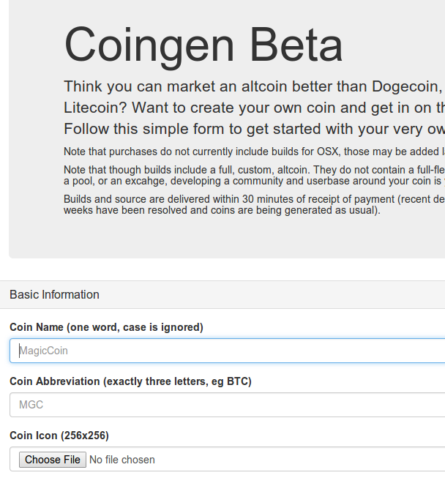
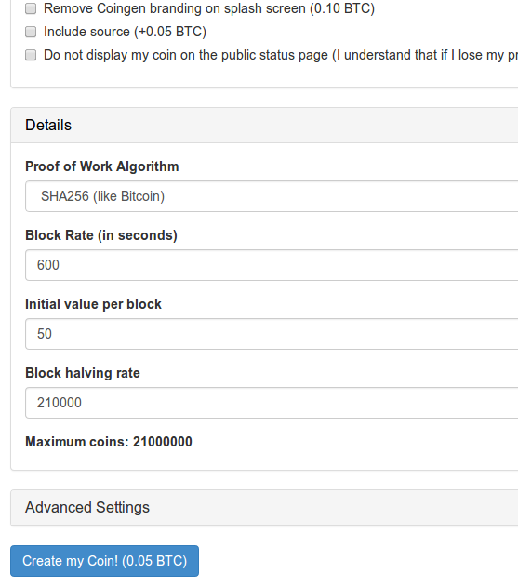
archive of http://coingen.bluematt.me/
Automated Altcoin Generator

Slide 31
Altcoin infrastructure
Tipbots, faucets
Logos, brand, marketing
Exchanges, payment processors
Developer tools, block explorer, testnet
Steering foundation

Slide 32
Initial Allocation / Fundraising
Pre-mine: founders get a Altcoin stash
Pre-sale: founders get a stash of Bitcoin or $
Proof-of-Burn (Unilateral pegging):
Destroy 1 unit of Bitcoin, earn one unit of Altcoin
Ownership of Bitcoin “grandfathered” in
Airdrop: give coins to members of some group
Notes:
2 way pegging

Slide 33

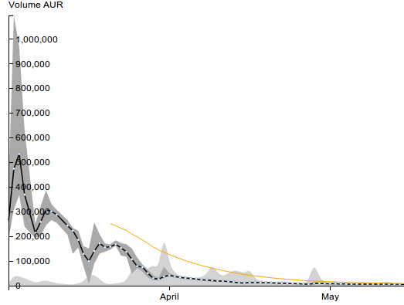
Auroracoin
Launched Jan 24, ‘14
Airdrop: Every Iceland citizen can claim 31.8 AUC, starting Mar 25, ‘14
Population: ~330k so 10.5M potential giveaway
Founder holds keys to 50% (10.5M of 21M)
Result: 3.5M in circulation
Uncertainty in money supply
Accountability?
Called a Pump-and-Dump
Airdrop begins, March 25
March

Slide 34
The Pump-and-Dump cycle
1. Begin with an altcoin about to launch
or an existing low-value, declining altcoin
2. Attacker buys lots of coins
3. Attacker launches marketing campaign to convince the public that altcoin has grassroots support
4. Attacker sells coins once price rises
5. Marketing campaign ends, altcoin declines

Slide 35
Arguments against altcoins
Position: altcoins harm the whole ecosystem
Divided mining power means weak security
Dilution of scarcity
Pump-and-Dump schemes

Slide 36
Arguments for altcoins
Position: Altcoins essential part of ecosystem
Competition leads to better systems
Bitcoin community is too risk averse
Altcoins are a testbed for new features
Hedging against uncertainty/failure
Multi headed hydra
“Jubilee” - reset the allocation of wealth

Slide 37
Bitcoin-Backed Altcoins, “Side Chains”

Slide 38
Bitcoin-to-Altcoin value transfer
Launch an Altcoin, convince BTC users to join
Options discussed so far are extremes:
“Grandfather”: all BTC holders get one
no risk taken - Altcoin crashes, nothing changes
Unilateral exchange: burn BTC, get ALT
full risk taken - Altcoin crashes, lost your BTC

Slide 39
Bitcoin as a reserve currency
Unilateral peg
Bilateral peg
1 BTC deleted forever!
1 ALT created
A
?
1 BTC held in escrow
1 ALT created
A
...
...
1 BTC released
1 ALT destroyed
A

Slide 40
Side chains
Proposal:
Bitcoin transactions that describe Altcoin’s validation rules
1 BTC - Can only spend after presenting evidence that 1 ALT has been deleted
1 ALT destroyed
A
Naively, to support this transaction, every Bitcoin node must store all of the data for Altcoin

Slide 41
Side chains - Improving efficiency
Requires validating every transaction
Idea:
Only need to support SPV security
Instead of TX is in Longest Valid Blockchain,
TX is in Longest Blockchain
1 BTC - Can only spend after presenting evidence that 1 ALT has been deleted
Only involves checking Block headers

Slide 42
Goal: compact SPV proofs
If an Altcoin has a very fast block rate, checking an SPV proof may still be slow
O(N) time to check O(N) blocks
Idea: instead of just a chain, store blocks in a structure supporting probabilistic SPV proof
O(polylog N) time to check O(N) blocks

Slide 43
Proof-of-Work sample
Suppose we have 4 blocks of difficulty 2⁻⁴
Every hash begins with at least 4 zero bit 0000
On average, half of the blocks have 5 00000
One of the blocks would have a 6th 000000
00001010
00000010
00001110
00000110

Slide 44
Proof-of-Work sample
Average number of hashes needed to find FOUR hashes with 4 zero bits is 4 * 2⁴ = 64
Same as average needed just to find ONE hash with 6 zero bits.
Idea: Why not just check block with most bits?
00001010
00000010
00001110
00000110
00000010

Slide 45
Proof-of-Work sample
Suppose an attacker only computes 32 hashes
Probability of finding FOUR 4-hashes is 14%
Probability of finding ONE 6-hash is 40%
Lesson: more samples, more precise estimates
00001010
00000010
00001110
00000110
00000010

Slide 46
Proof-of-Work skiplist
Example: data structure for 1/4 samples
Every block points to prev AND to the most recent 6+
...
4
5
5
4
6
4
5
4
6
4
5
4
4
7
4
4
To checking a compact SPV proof, follow the red arrows
… this can be generalized to an ordinary skip list

Slide 47
Side Chains - Conclusion
Altcoins that hold Bitcoin in reserve
Could smooth Altcoin launch risks
Requires changes to Bitcoin for support
Like other Altcoins, could be merge mined
… or avoid merge mining with an alternate puzzle

Slide 48
Conclusion
Bitcoin and hundreds of Altcoins coexist
Compete and interact, supportively or destructively
Atomic swaps, merge mining supported today
More interactions may be supported in the future
Questions:
Will Altcoins consolidate or diversify further?
Will Bitcoin be overtaken by an Altcoin?
Embrace interaction with Altcoins or avoid them?

Slide 49
In the next lecture...

Slide 50
Lecture 11: The future of Bitcoin?
Can Bitcoin lead to a decentralized society?
Autonomous agents, smart property

